Slide 1
FCH JU
Support to Electrolysis Development
Nikolaos Lymperopoulos
HPEM2GAS Workshop
Emden, 12th February 2019

Slide 2



Strong public-private partnership with a focused objective
EU Institutional Public-Private Partnership (IPPP)
Fuel Cells & Hydrogen Joint Undertaking (FCH 2 JU)
Industry grouping
More than 130 members
50% SME
Research grouping
over 60 members
To implement an optimal research and innovation programme to bring FCH technologies
to the point of market readiness by 2020
Notes:
The Fuel Cells and Hydrogen Joint Undertaking (FCH JU) is a unique public private partnership supporting research, technological development and demonstration (RTD) activities in fuel cell and hydrogen energy technologies in Europe.
Its aim is to accelerate the market introduction of these technologies, realising their potential as an instrument in achieving a carbon-lean energy system.
The three members of the FCH JU are the EU (represented by the European Commission), fuel cell and hydrogen industries represented by Hydrogen Europe and the research community represented by Hydrogen Europe Research.

Slide 3


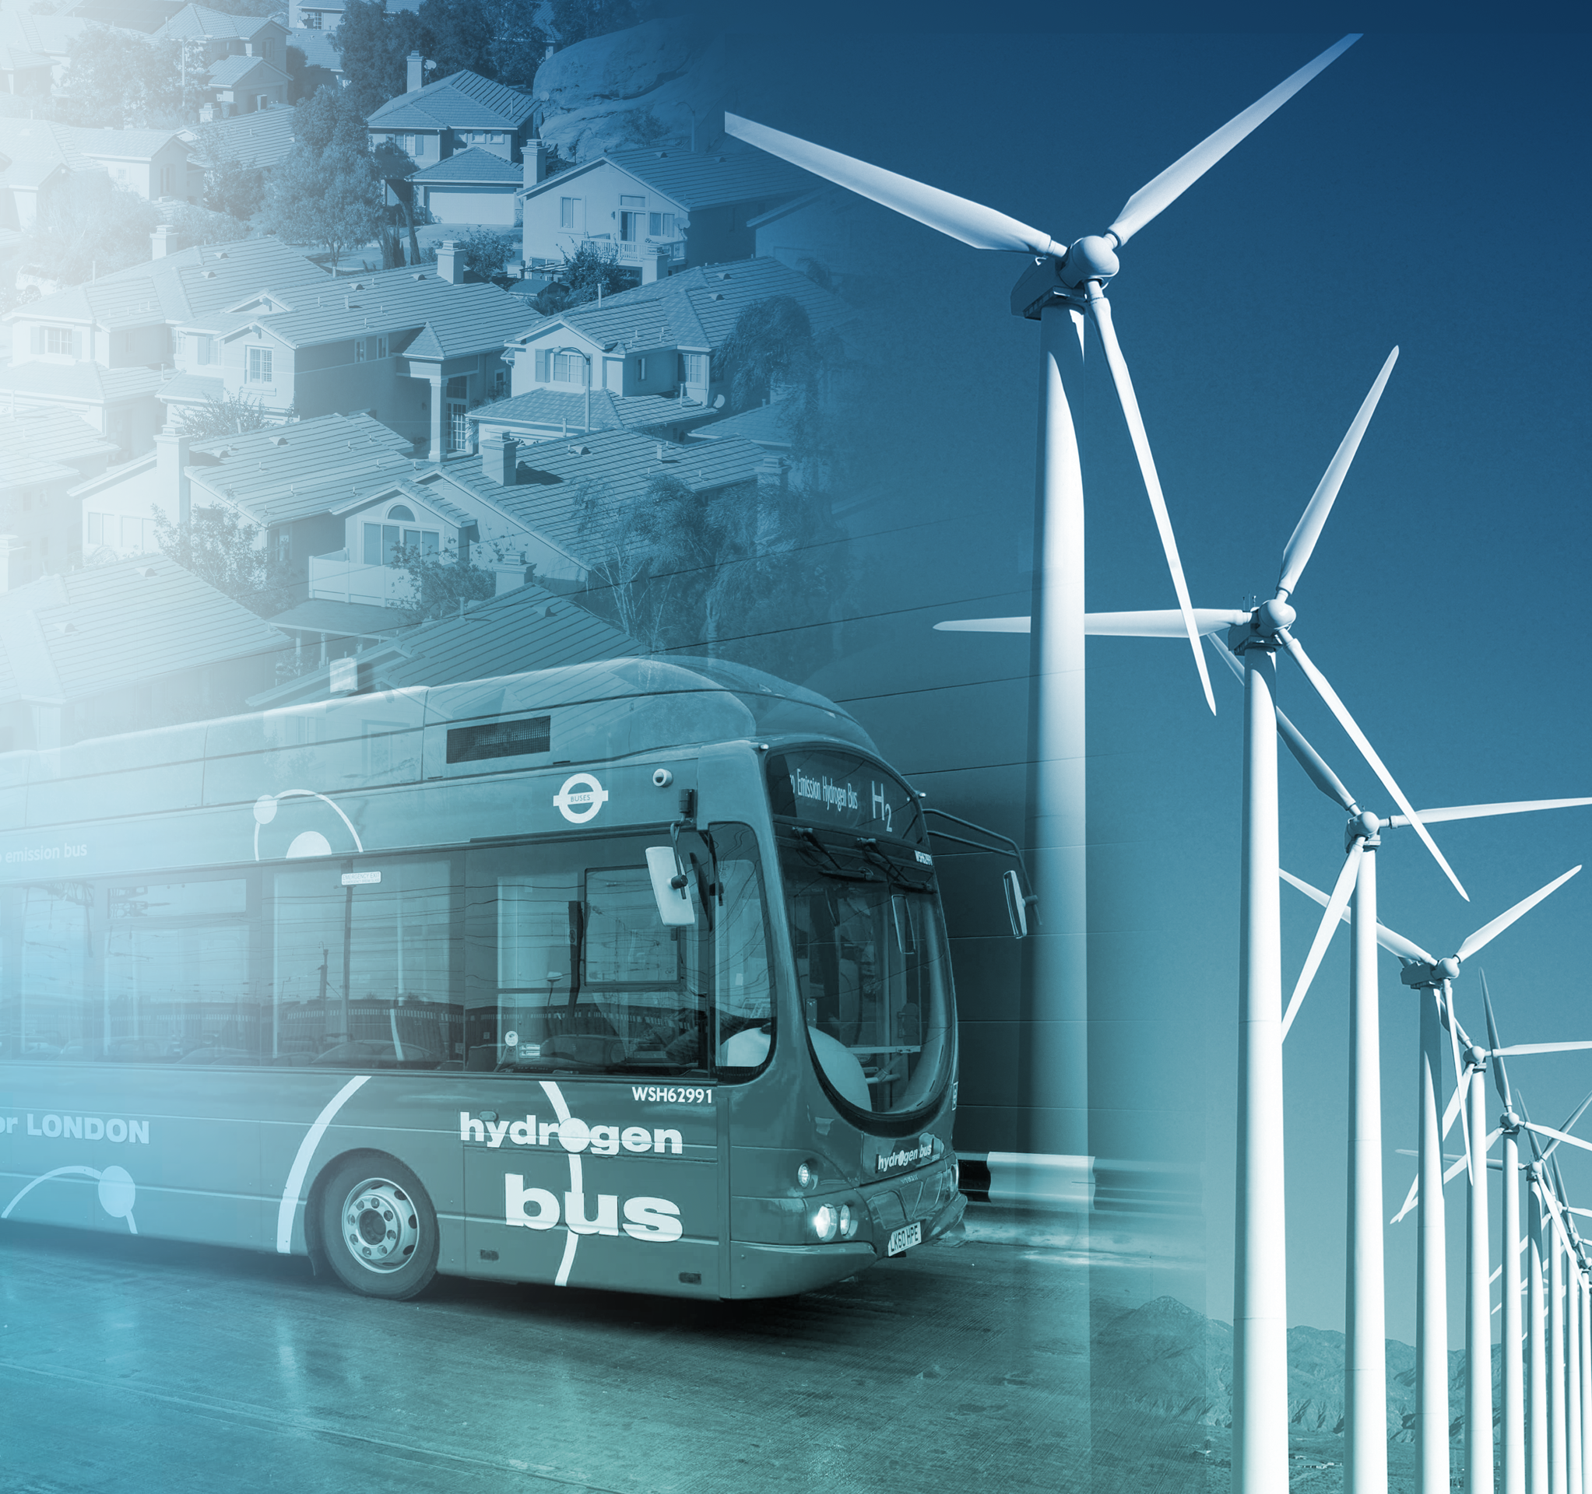




FCH 2 JU Objectives
Market readiness of a portfolio of clean, efficient and affordable solutions for our energy and transport systems
Clean Transport
Reduce fuel cell system costs for transport applications
H₂ storage for grid balancing
Demonstrate on a large-scale hydrogen’s capacity to harness power from renewables and support its integration into the energy system
Green hydrogen production
Increase efficiency and reduce costs of hydrogen production, mainly from water electrolysis and renewables
Minimal use of critical raw materials
Reduce platinum loading
Heat & electricity production
Increase fuel cell efficiency and lifetime
Notes:
(COUNCIL REGULATION (EU) No 559/2014 of 6 May 2014 establishing the FCH 2 JU)
The FCH 2 JU shall have as strategic objective to demonstrate by 2020 fuel cell and hydrogen technologies as one of the pillars of future European energy and transport systems, making a valued contribution to the transformation to a low carbon economy by 2050.
Vision 2020
To develop by 2020 to the point of market readiness a portfolio of clean, efficient and affordable solutions that fully demonstrate the potential of H2 as an energy carrier and fuel cell as energy convertor, as part of an energy system that integrates sustainable solutions and energy supplies with low carbon stationary and transport technologies.

Slide 4






FCH JU programme implementation
Energy
47 %
Hydrogen production and distribution
Hydrogen storage for renewable energy integration
Fuel cells for power & combined heat & power generation
418 million euro
135 projects
244 projects supported for
893 M€
42 %
Transport
376 million euro
65 projects
Road vehicles
Non-road vehicles and machinery
Refuelling infrastructure
Maritime rail and aviation applications
6 %
53 million euro
40 projects
Cross-cutting
E.g. standards, safety, education, consumer awareness …
5 %
46 million euros
4 projects
Similar leverage of other sources of funding: 892 M€
Notes:
Overarching projects take budget from both Energy and Transport Pillar

Slide 5







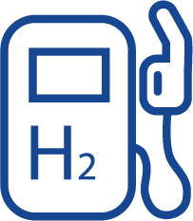



Early H₂ Production: a facilitator of FCs in Transport and Energy
P2P & FCEVs + “Where will the Hydrogen come from?
  POWER GRID
Power-to-Industry
Wind turbine
Balancing services
Steel
Ammonia
Speciality Chemicals
Power
Power-to-Hydrogen
Solar PV
Chemical plants
Power-to-power
Electrolysis
H₂ storage (optional)
Gas turbines
Fuel Cells
CHP
H₂O
Power-to-Gas
O₂
Power-to-Fuels
Refineries
Methanation
Power-to-Refinery
Methanol
CNG
CO₂
CO₂
Power Network
Heat
Hydrogen Network
Blending
Refueling stations
Liquid fuels Network
Power-to-Mobility
Gas Network
Hydrogen Vehicles (FCEV)
GAS GRID
Notes:
Connecting the Power, Gas and Transport sectors

Slide 6



Today’s H₂ Production: enabler of Sectorial integration
H₂ is the best option for deep decarbonisation for a number of sectors
  POWER GRID
Power-to-Industry
Wind turbine
Balancing services
Ammonia
Steel
Specialty Chemicals
Power
Power-to-Hydrogen
Solar PV
Chemical plants
Power-to-power
Electrolysis
H₂ storage (optional)
Gas turbines
Fuel Cells
CHP
H₂O
Power-to-Gas
O₂
Power-to-Fuels
Refineries
Methanation
Power-to-Refinery
Methanol
CNG
CO₂
CO₂
Power Network
Heat
Hydrogen Network
Blending
Refueling stations
Liquid fuels Network
Power-to-Mobility
Gas Network
Hydrogen Vehicles, Trains, Ships
GAS GRID
Notes:
Cost of PV modules fell by 80% since 2009 and cost of electricity by ¾. On shore wind is at 0.07US$/kWh and solar at 0.10US$/kWh, however LCOE can be lowered to 0.03 by 2020.
Connecting the Power, Gas and Transport sectors
O2 from electrolysis could be used to double the yield of biofuels for given feed, by using the O2 in an enhanced oxygen gasifier.

Slide 7

Hydrogen for Sectorial Integration
Well-positioned FCH JU objectives & Budget
Increase efficiency
and reduce costs of H₂
production, mainly from
water electrolysis and
renewables
Demonstrate on a large scale
H₂’s capacity
to harness power from
renewables and support
its integration into the
energy system
Related FCH JU Objectives
54 M€
    E N E R G Y
H₂ production, distribution & storage
154 M€
    T R A N S P O R T
285 M€
17.2%
102 M€
154 M€
57 Projects
131 M€
167 M€
Notes:
* In the total budget 2 projects (wind2Hyrail – panel 5 & H2Haul-panel 1) are excluded as they are still not signed.

Slide 8








Hydrogen Production Technical Coverage
95% of FCH JU support to green Hydrogen production
Nuclear Energy
  RES
Fossil Fuels
Heat
Biomass
3
1
Photo Electrolysis
Gasification
5
  Electricity
Reforming
4
31
1
Thermolysis of water
  Electrolysis
  Biological
Hydrogen
CO₂
12
Distr., Storage, Purification

Slide 9



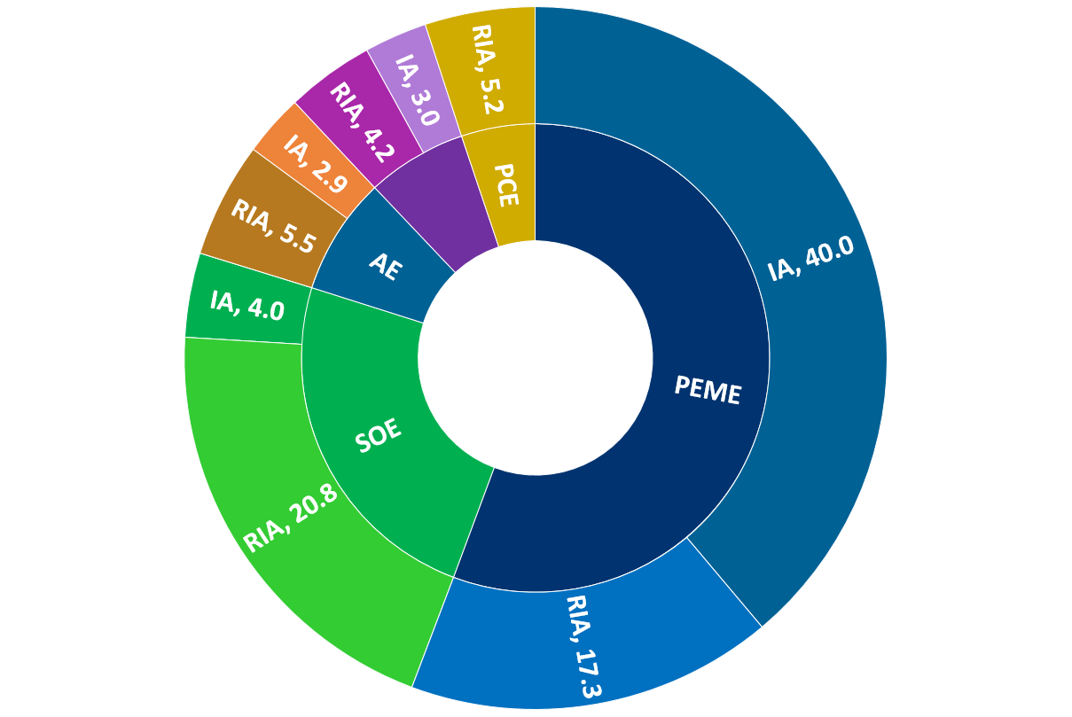
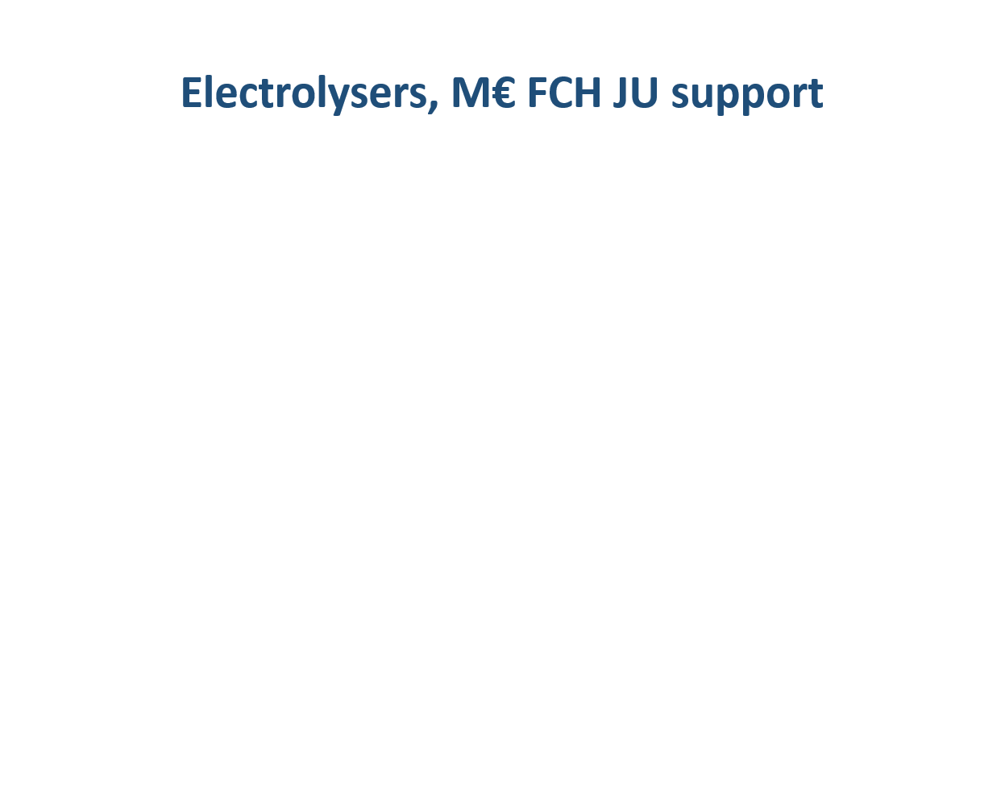
Electrolysis Research and Demonstration
The potential of Hydrogen for the greening of industry has lead to fast capacity increase and cost reduction
HRS
Steel industry
Refineries
Food industry
RIA: Research & Inovations Actions (RTD)
IA: Innovations Actions (Demo)
Electrolyser Demo Projects
103 M€
31 Projects
Notes:
PCE: Proton ceramic Electrolyser, project Electra

Slide 10

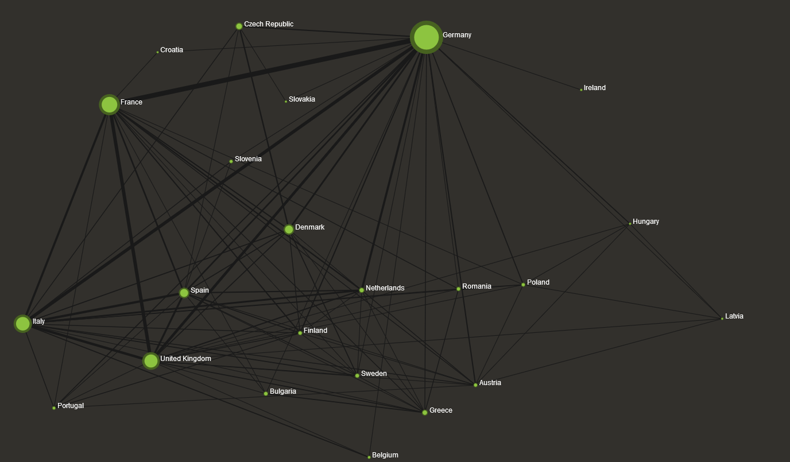
PEM electrolysis: EU leadership
Total Number of publications, patents, events from 2004 to 2017
Japan
DE
US
FR
China
DK
S. Korea
I
EU
UK
EU 823, US 430, China 270, JPN 193, S. Korea 143
DE 224, FR 136, I 116, UK 111, DK 62

Slide 11
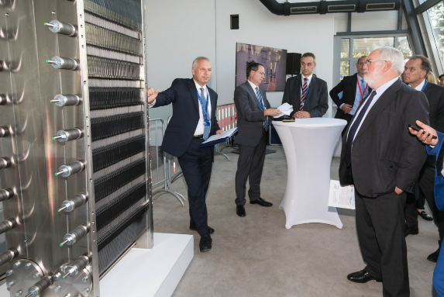
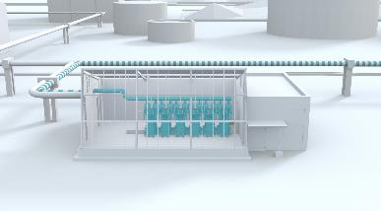
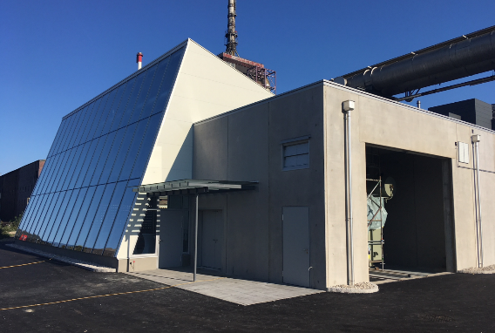
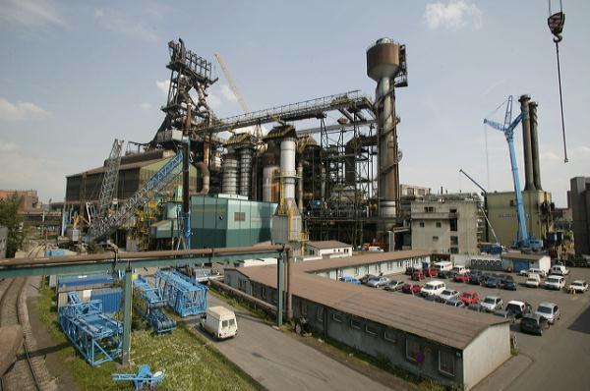

2016: Greening the Steel Industry
The H2Future Project: Producing green H2 from hydro power, Injecting in steel industry, providing grid services
Co-ordinated by Verbund (electricity company of Austria)
6MW PEM atmospheric electrolyser by Siemens
Installed in voestalpine (steel industry) in Linz
H2 injected in coke oven gas. Long term view is direct iron ore reduction through H2
Favourable electricity tariffs in Austria for electrolysers
Steel industry a great proponent of green H2 at Commission level
TOT 18 M€
Partners
6 M€
FCH JU
12 M€

Slide 12

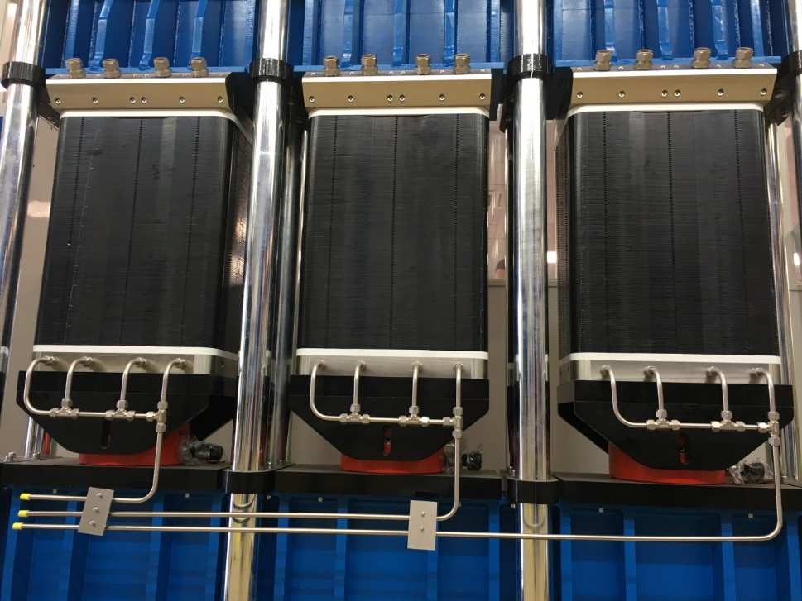
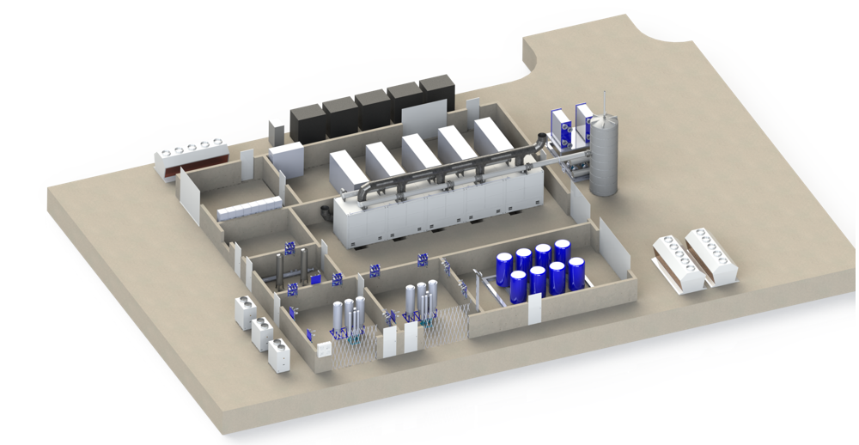
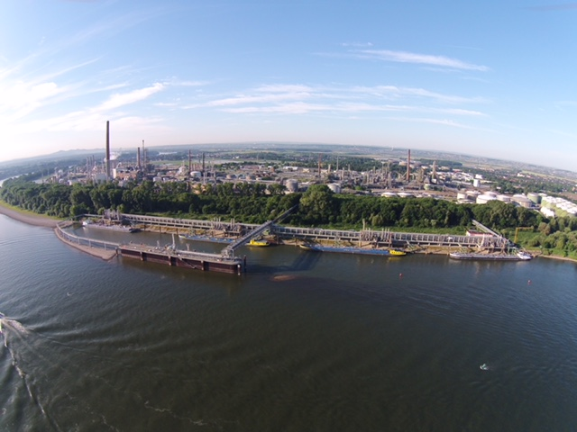
2017: Greening the Refining Industry
The Refhyne Project: Producing green H2 from renewables, displacing grey SMR hydrogen
10MW PEM electrolyser by ITM Power installed in Shell refinery in Wesseling, Germany
3 A/cm2, 30bar
H2 fed to existing pipeline – grid and load balancing services
Displacing 1% of 180,000 tons annual consumption
TOT 16 M€
Partners
6 M€
FCH JU
10 M€

Slide 13



Pushing the limits of electrolysis
2017 Game-changer electrolysis projects
NEPTUNE project
self-pressurizing 100 bar PEM electrolyser system of 48-115 kW
current densities of 4-8 A⋅cm-2, <50 kWh/kg H2
at least 4,000 hours (cumulative, 2000 h steady-state, 2000 h cycled operation)
PRETZEL project
Cell concept capable of 100 bar, PEM electrolyser system of 25 kW
current densities of 4-6 A⋅cm-2, non-precious metal coatings
at least 2000 h operation
GAMER project
Tubular proton ceramic electrolyser @ 30 bar, 10kW
Integrated steam electrolyser to produce dry pressurized H2
current densities of 4-6 A⋅cm-2.
Operation @ 500-700 ºC
Notes:
Operation at 100 bar, current densities of 4 up to 8 Amps per cm2, compared to today’s 2-3

Slide 14
Hydrogen injection in the NG grid
2019 call for proposals: three topics
FCH-02-1-2019: Combined electrolyser-HRS and Power-to-Gas system
Up to 600kg/d injection at NG distribution (low pressure) grid
FCH-02-5-2019: Systematic validation of the ability to inject hydrogen at various admixture level into high-pressure gas networks in operational conditions
Up to 120kg/d injection at NG transmission (40-80bar) gas grid
FCH-04-3-2019: Hydrogen admixtures in natural gas domestic and commercial end uses
Impact of 10-60% H2 in NG injection to combustion characteristics, appliances performance and safety
Notes:
Operation at 100 bar, current densities of 4 up to 8 Amps per cm2, compared to today’s 2-3

Slide 15
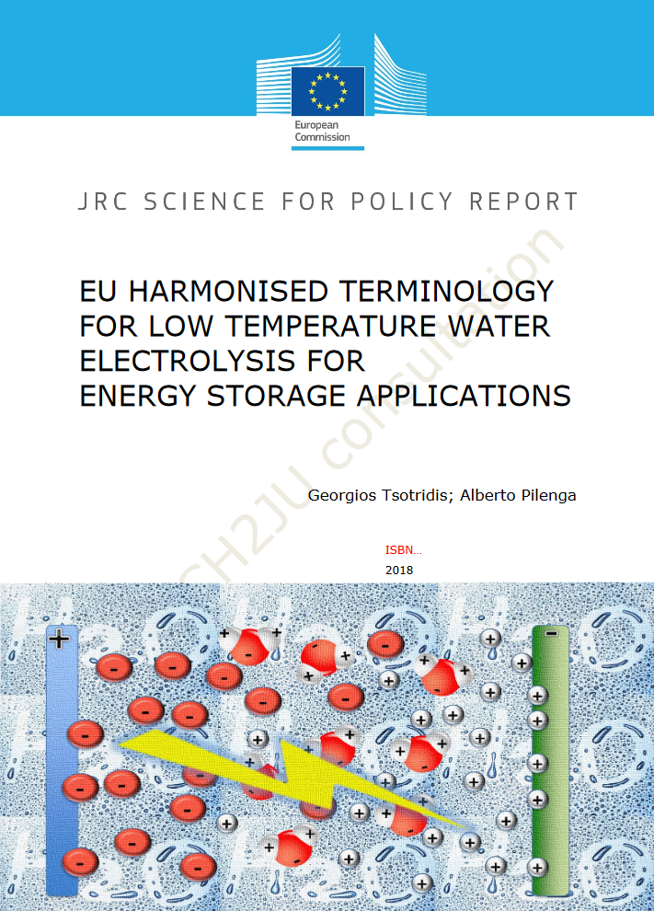
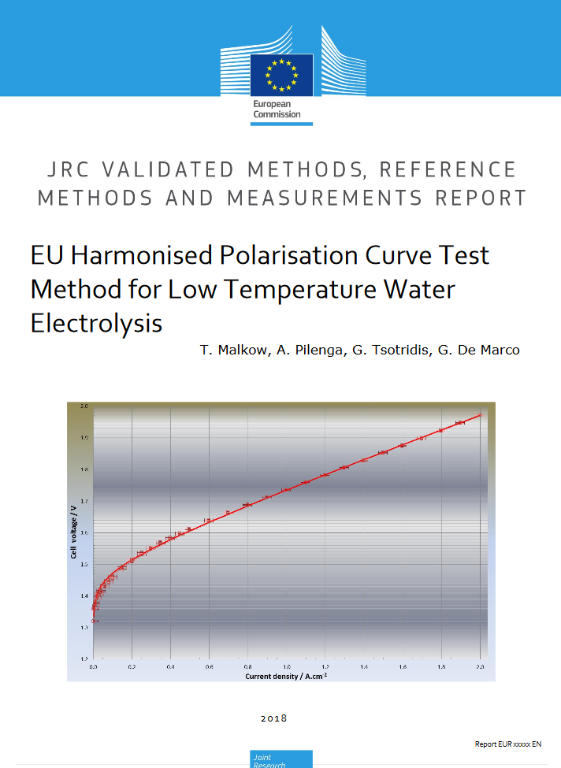
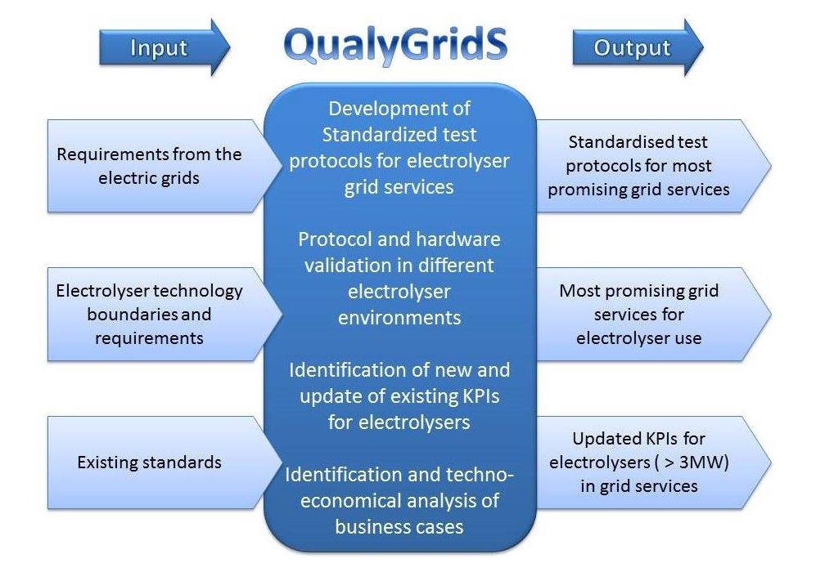

Standardisation of electrolyser testing protocols
Two parallel efforts
JRC standardisation of testing @ cell and stack level: two documents finalised
QUALYGRIDS project standardisation of testing @ system level

Slide 16


Summary
  Sectorial integration, Energy storage, Decarbonizing industry & the Gas grid: mainstream energy policy terms
    H₂: important component – Electrolyser: key technology
    FCH JU: continuous support in moving electrolysers from kW to MW, improving performance & reducing costs
  The HPEM2GAS project is a major contributor in developing a flexible, high pressure electrolyser operating on high current density with reduced degradation, demonstrated @ 180kW in a P2G application

Slide 17



Nikolaos Lymperopoulos
Project Officer
Nikolaos.Lymperopoulos@fch.europa.eu
For further information
www.fch.europa.eu
@fch_ju
Fch-ju@fch.europa.eu
FCH JU

